Slide 2
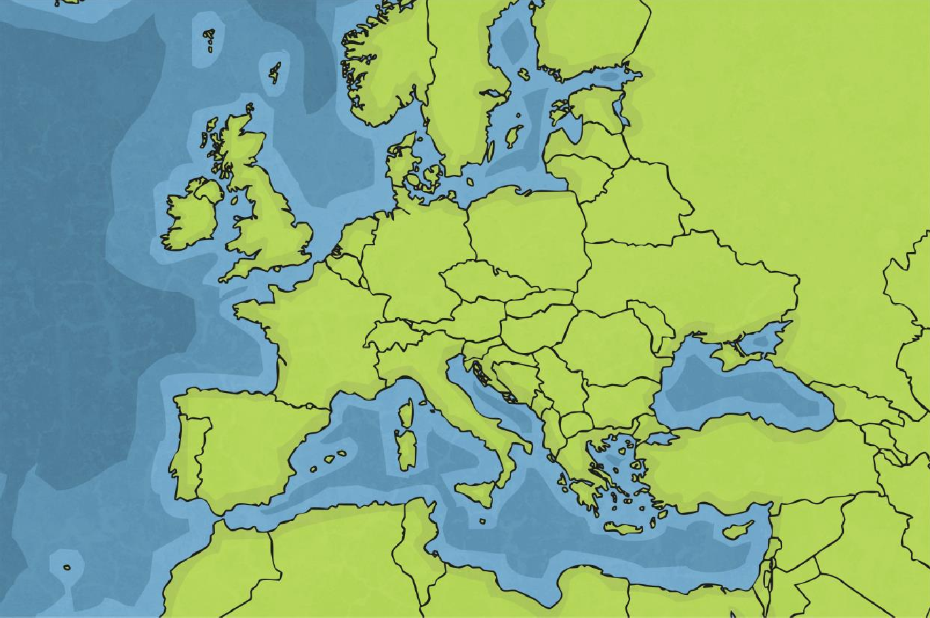
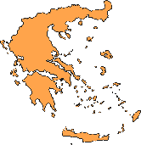
Where in the World Is Greece?
Greece is a country in Europe. It shares borders with Albania, Turkey,
PGDM and Bulgaria.

Slide 3
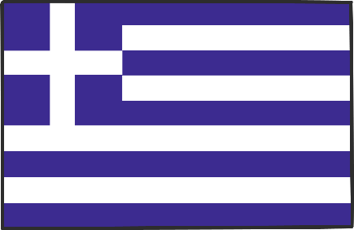
Greece: The Facts
Name: | Greece
Capital city: | Athens
Currency: | Euro (€)
Population: | 11 million
Language: | Greek
Average rainfall: | 50 – 121cm in the north 38 – 81cm in the south
Flag of Greece (Hellenic Republic)

Slide 4
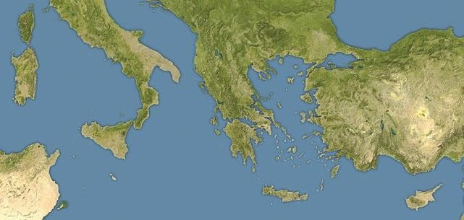
Coastline
Greece has 8479 miles of coastline. In fact, no point is more than 85 kilometres from the coast.
Aegean Sea Mediterranean Sea Ionian Sea
Aegean Sea
Ionian Sea
Mediterranean Sea
SHhiodwe AAnnsswweerrss

Slide 5
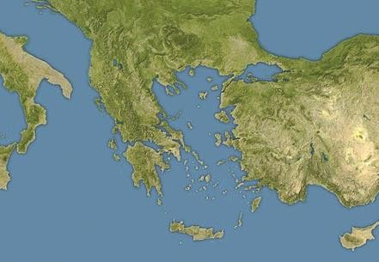
Islands
There are over 2000 islands that make up the Greek nation. Around 170 of these islands are populated. If you counted every rocky outcrop, however, the number of islands would total more than 3000. Islands account for around 20% of the country’s land area.
Crete is the largest of
the Greek islands.
Other beautiful islands
is Santorini with the
famous sunset,
Rhodes and many more!
Have you been on holiday to Greece? Did you stay on one of the islands?

Slide 6
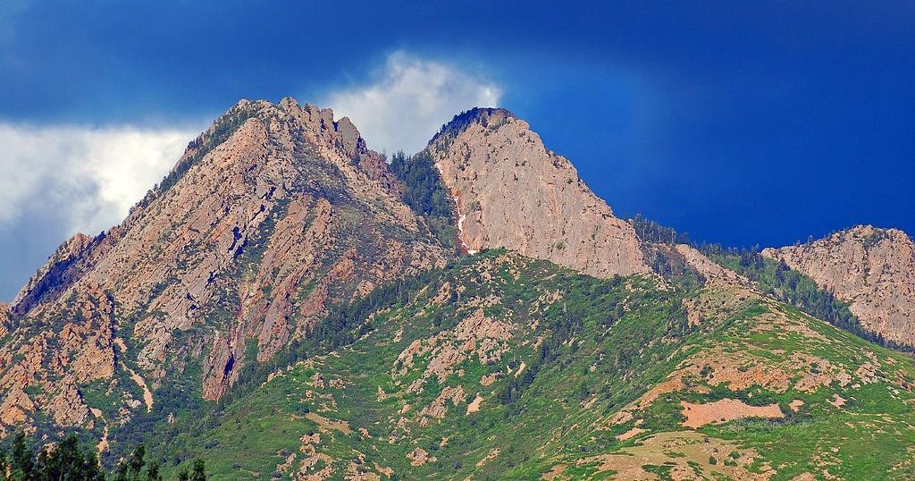
Mainland Greece
Greece is one of the most mountainous countries in Europe.
In Greek mythology, Mount Olympus is said to be the seat of the Gods.
Mount Olympus is the highest mountain in Greece. It measures 9754 feet high (3 kms).
Photo courtesy Brett Neilson (@flickr.com) - granted under creative commons licence - attribution

Slide 7
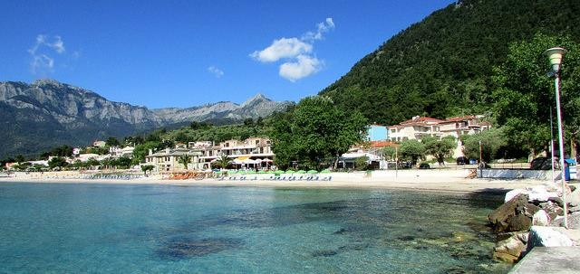
Mainland Greece
Greece has a warm, sunny climate and enjoys more than 250 days of sunshine a year. It has a typically Mediterranean climate with hot, dry summers and mild, rainy winters. Most people consider Greece to be a summer holiday destination, although there are also popular ski resorts in the mountainous
regions to the north of Athens.
Photo courtesy Ronald Saunders (@flickr.com) - granted under creative commons licence - attribution
Average summer temperature: | 33°C | Average winter temperature: | 10°C
Average summer rainfall: | 6mm | Average winter rainfall: | 65mm

Slide 8
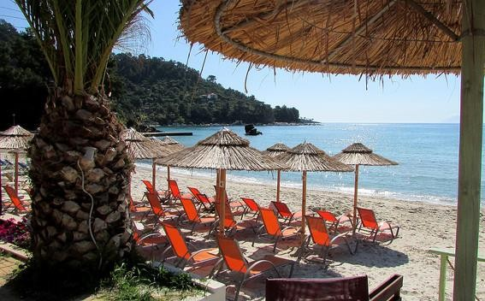
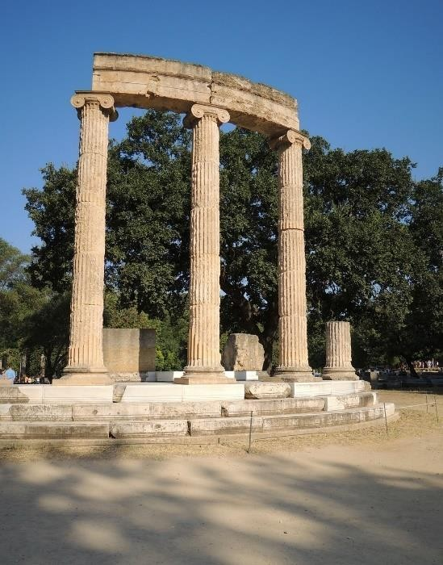
Tourism
Because of its warm weather and beautiful scenery, Greece is a popular destination for tourists. It is one of the most visited countries in the world, largely due to its Mediterranean climate and extensive coastline. With 18 UNESCO World Heritage Sites, Greece is rich in culture and history.
This Ancient Greek site was the birthplace of a sporting event still celebrated today.
Photo courtesy Ronald Saunders (@flickr.com) - granted under creative commons licence - attribution
This is Olympia, the site of the very first Olympic Games held in 776BC.
26.5 million tourists visited Greece in 2015. That’s more than the Greek population!

Slide 9
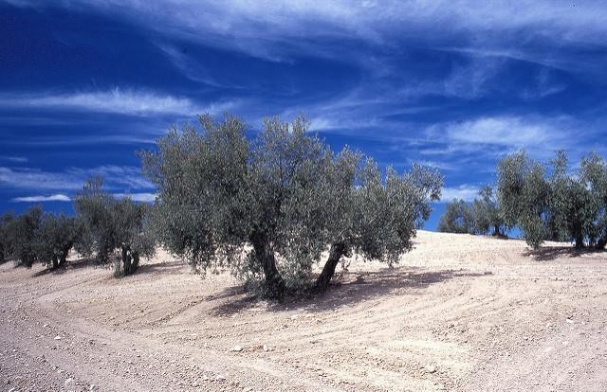
Greek Food
The most recognisable Greek food is the olive. Greek legend tells how the Greek Gods Athena and Poseidon both wanted to be guardian over the city of Athens. To decide the matter, whoever gave the city the best gift would become guardian. Athena’s gift of an olive tree was thought to be more valuable than Poseidon's gift of water.
An olive wreath was presented to the winner at the Ancient Olympic Games.
Did you know that olive trees can live for hundreds of years?
Photo courtesy Mark Hodson Photos (@flickr.com) - granted under creative commons licence - attribution

Slide 10
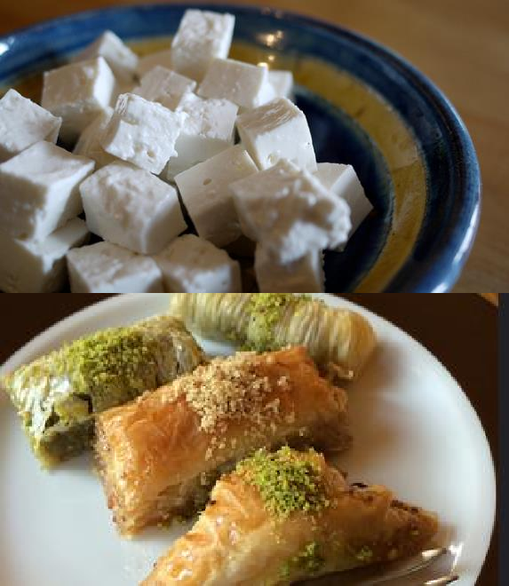
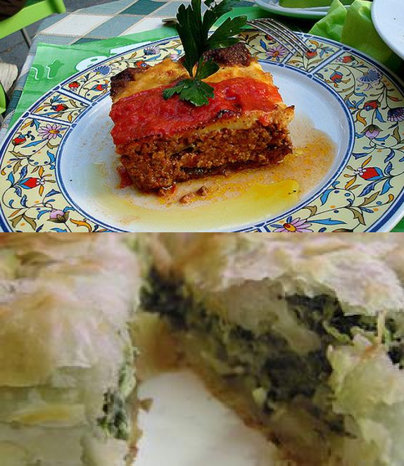
Greek Food
Small cafes, called Tavernas, serve delicious Greek food.
Feta cheese (Made with sheep and goat milk) | Moussaka (Minced lamb, aubergine and tomato)
Baklava (Filo pastry, nuts and honey) | Spinach and Cheese Pie (Filo pastry filled with spinach and cheese)
Photos courtes Rebecca Siegel, a_marga, Alper Çuğun and Dan4th Nicholas (@flickr.com) - granted under creative commons licence – attribution

Slide 11
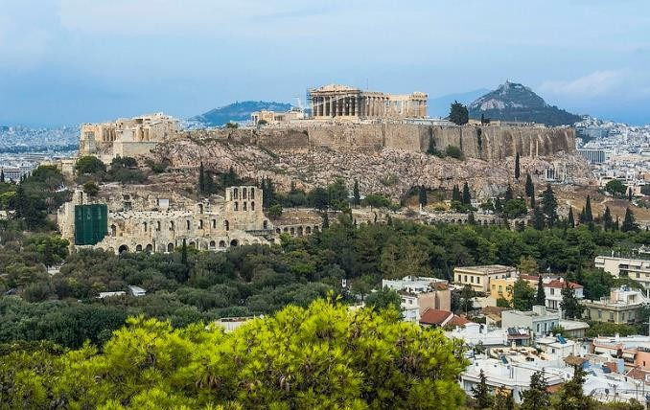
Athens
Athens is the birthplace of democracy, the system of electing a government, and is one of the oldest European cities. It has been continuously inhabited for more than 7000 years. Around 40% of the Greek population live here.
Photo courtesy Guillén Pérez (@flickr.com) - granted under creative commons licence - attribution

Slide 12
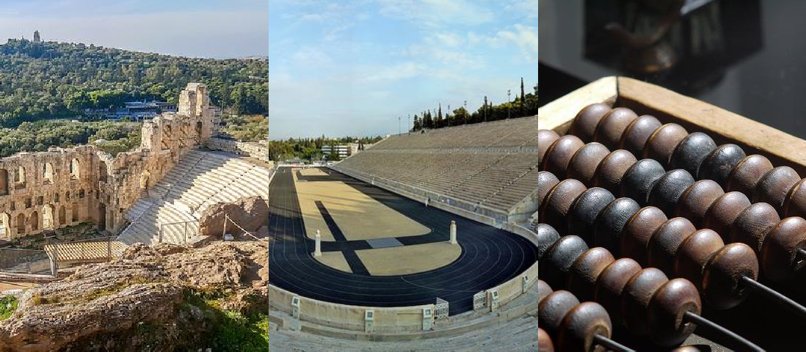
Ancient Greece
Ancient Greece inspired many things we still enjoy today.
Theatres | Olympic Games | Mathematics
Photos courtes Kostas Arvanitis, Robert Pittman and Samil (@flickr.com) - granted under creative commons licence – attribution

Slide 13
Ancient Greek Wonders
The Colossus of Rhodes, one of the Seven Wonders of the Ancient World, was destroyed by an earthquake around 2000 years ago. | The Parthenon is a former temple, dedicated to the Goddess Athena who is said to be the patron of Athens. | The Acropolis is an ancient citadel, located on a rocky outcrop above the city of Athens.
Photos courtes Nathan Hughes Hamilton, claire rowland and Andy K (@flickr.com) - granted under creative commons licence – attribution

Slide 14
Greek Traditions
Greek Dancing Traditional dances are about expressing emotions and telling stories. The ‘Kalamatiano’ is a celebratory dance performed by men and women, dancing in a circle. | Greek Homes Many Greek houses are painted white to reflect the sun. Blue and white also reflect the colours of the Greek flag- white and blue to symbolise the Greek sea and sky. | Greek Orthodox Church Religion is an important aspect of Greek culture. Around 98% of the population are Christian Orthodox.
Photos courtes James Nash and Brian Snelson (@flickr.com) - granted under creative commons licence – attribution

